Slide 1
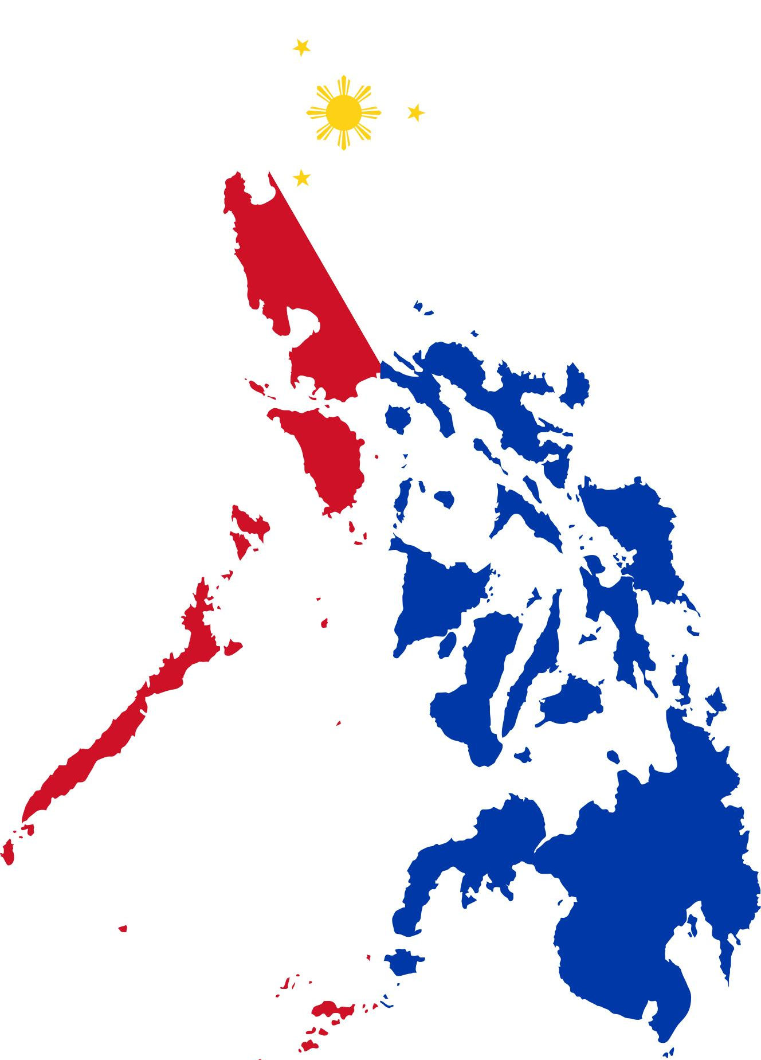
PHILIPPINES
BROWNE, CHERISH
LU, JAMIE
ODEBUNMI, ISLAMIYAT
SMITH, LEEANN
Notes:
https://www.iconspng.com/image/90925/philippines-map-flag

Slide 2

INTRODUCTION
The Philippines
In 1521 Portuguese explorer, Ferdinand Magellan, sailing for Spain discovered and claimed the Philippines. Named after King Philip II, they were then called Las Felipinas. Ruled first under Mexico based Vice Royalty of New Spain, the Philippines was then governed by Spain until Spanish rule ended in 1898. Due to defeat in the Spanish American War the Philippines became a territory of the United States.
This Photo by Unknown Author is licensed under CC BY-SA

Slide 3
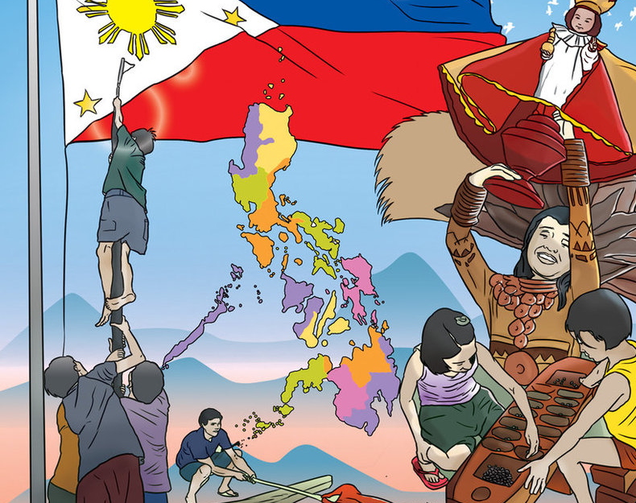
FILIPINO CULTURE
Notes:
https://www.facebook.com/filipinocultures/photos/a.1740597792647667/1740597639314349
The Discovery of the Deepest Beauty of Philippines Cultures

Slide 4

Tsismis / gossip
Rumour or idle talk regarding the private or personal affairs of other individuals
Has become a favorite pastime because it provides high entertainment value for little to no cost
Dates back to Spanish colonial era, Spaniards noticed Filipinos going in groups and talking for hours
Used as a survival mechanism, it helped build relationships and used to disclose trusted information vital to their survival.
Impacts how Filipinos understand the idea of privacy
Employees might share private information
Can lead to destruction of an individual or organization’s reputation
This Photo by Unknown Author is licensed under CC BY-SA-NC

Slide 5
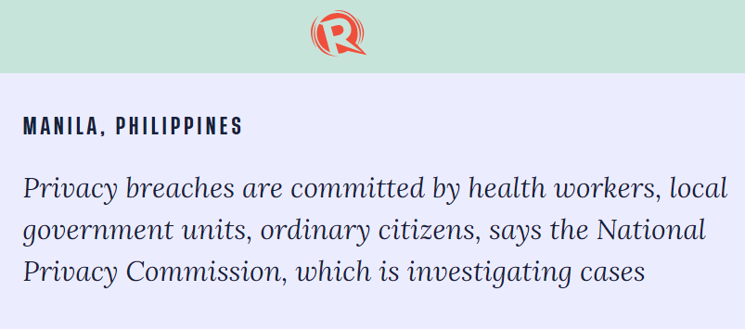
Notes:
https://www.rappler.com/newsbreak/in-depth/unauthorized-disclosure-covid-19-patients-identities-continues-npc

Slide 6

Utang na loob /
debt of gratitude
Sense of obligation to repay a person who has done you a favor
Good because it shows appreciation and gratitude
Bad because it can affect how a person acts or makes a decision
Can lead to blind loyalty, or when the recipients see the benefactors as perfect
This Photo by Unknown Author is licensed under CC BY-NC-ND

Slide 7

E T H I C S

Slide 8
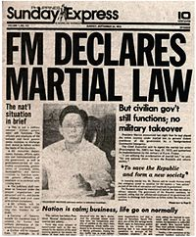
MARTIAL LAW
Declared when there is violent civil unrest; most countries use a different legal construct like “state of emergency”
Imposition of martial law accompanies curfews, suspension of civil law, civil rights, habeas corpus, and the application or extension of military law or military justice to civilians.
This Photo by Unknown Author is licensed under CC BY-SA

Slide 9
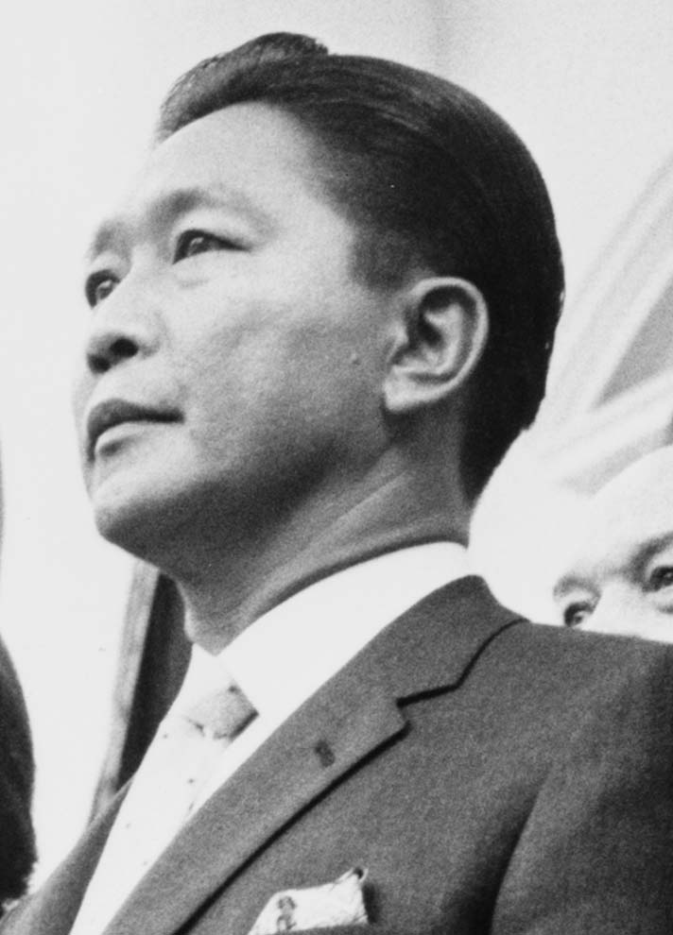
MARTIAL LAW IN THE PHILIPPINES
Marcos Regime (1965-1986)
Former President Ferdinand Marcos
In the start of his term, the country was under the 1935 Constitution
president would have a term of 4 years and a maximum of 2 consecutive years in office
In 1971, a constitutional convention was held to rewrite the 1935 Constitution. There were a lot of speculations of bribery and corruption in the convention but one issue that was very controversial was the elimination of the term limit for the President. This allowed people’s suspicions on the real reason why the convention was called.
A constitutional dictator
Under the 1973 constitution, was able to suspend habeas corpus place the country under martial law in the event of violence, invasion, insurrection, or rebellion.
Argued that Martial Law was done in response to the “communist threat” by the Communist Party of the Philippines, and the sectarian “rebellion” of the Mindanao Independence Movement (MIM)
Suspended Habeas Corpus and the 1935 Constitution, dissolved Congress, padlocked the doors to the Batasang Pambansa, and assumed both legislative and executive powers.
This Photo by Unknown Author is licensed under CC BY-SA

Slide 10
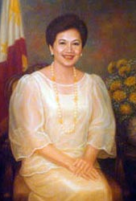
AQUINO ADMINISTRATION (February 25, 1986 – June 30, 1992)
Between February 22 – 25 1986 the Filipino people held nonviolent demonstrations against the current regime, known as EDSA or the People Power Revolution, the result was President Corazon Aquino (1986-1992). The first woman President of the Philippines.
Majority of the laws that the Philippines has today were created to rectify the human rights issues from the Marcos era.
Aquino drafted the 1987 constitution, establishing 3 government powers. Executive, Legislative and Judicial branches, each with limitations and safeguards to ensure a democratic government.
The constitution also allowed for the creation of 3 independent constitutional commissions, Civil Service, Elections and Audit commissions, all with the intention of establishing and ensuring an ethical and lawful government.
This Photo by Unknown Author is licensed under CC BY-SA

Slide 11

PREAMBLE
“We, the sovereign Filipino people, imploring the aid of Almighty God, in order to build a just and humane society and establish a Government that shall embody our ideals and aspirations, promote the common good, conserve and develop our patrimony, and secure to ourselves and our posterity the blessings of independence and democracy under the rule of law and a regime of truth, justice, freedom, love, equality, and peace, do ordain and promulgate this Constitution.”
- 1987 Philippine Constitution
This Photo by Unknown Author is licensed under CC BY-SA

Slide 12

Ethical Regulations
Section 4 Conduct of Public Officials and Employees
Commitment to public interest
Professionalism
Justness and Sincerity
Political Neutrality
Responsiveness to the Public
Nationalism and Patriotism
Commitment to Democracy
Simple Living
Section 7 Prohibited Acts and Transactions
Financial and Material interest
Outside employment and other activities
Disclosure and or misuse of confidential information
Solicitation or acceptance of gifts

Slide 13
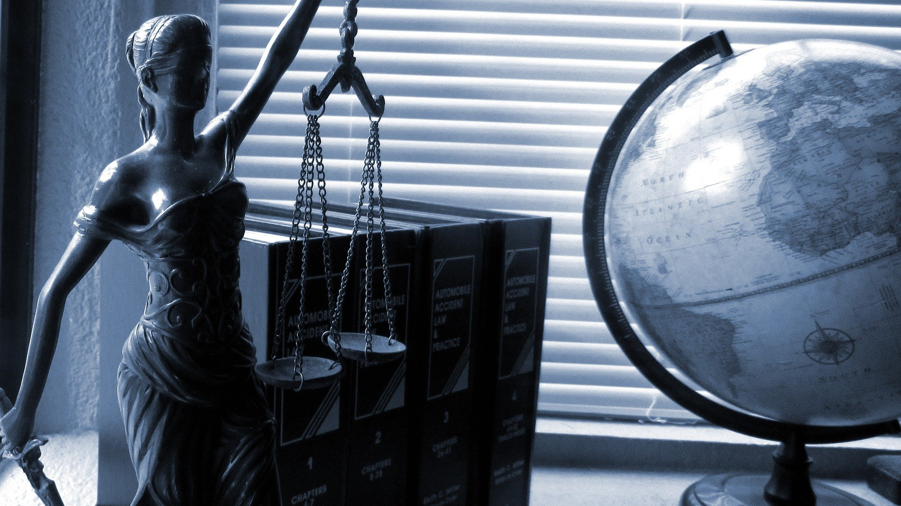
LEGISLATION
The main sources of law in the Philippines are:
1) Philippine Constitution
2) Statutes
3) Treaties and conventions
4) Judicial Decisions
Notes:
PHOTO FROM: Image by <a href="https://pixabay.com/users/jessica45-2055892/?utm_source=link-attribution&amp;utm_medium=referral&amp;utm_campaign=image&amp;utm_content=2388500">jessica45</a> from <a href="https://pixabay.com/?utm_source=link-attribution&amp;utm_medium=referral&amp;utm_campaign=image&amp;utm_content=2388500">Pixabay</a>

Slide 14
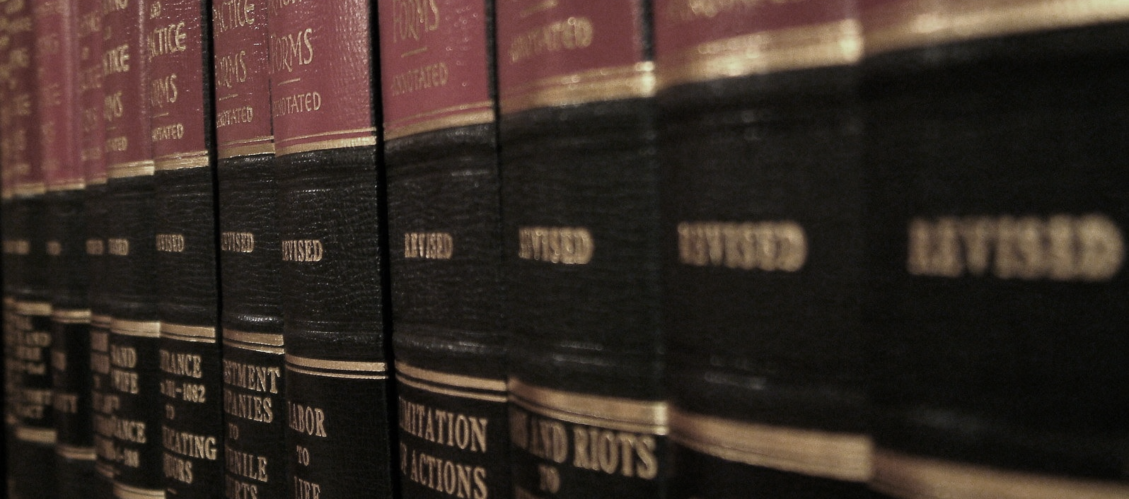
L A W S
Notes:
Photo from https://www.freeimages.com/photo/law-series-4-1467436

Slide 15
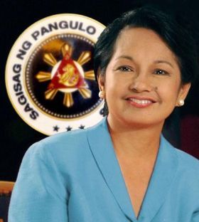
Arroyo Administration January 20, 2001 to June 30, 2010
Former President Gloria Macapagal Arroyo
Assumed presidency after elected President Estrada was ousted following EDSA II Revolution
Height of extrajudicial killings and forced disappearances.
Prompted the creation of the writ of Amparo and the writ of Habeas Data.
This Photo by Unknown Author is licensed under CC BY-SA

Slide 16

WRIT OF AMPARO
PROTECTION
Notes:
STOCK PHOTO FROM POWERPOINT

Slide 17
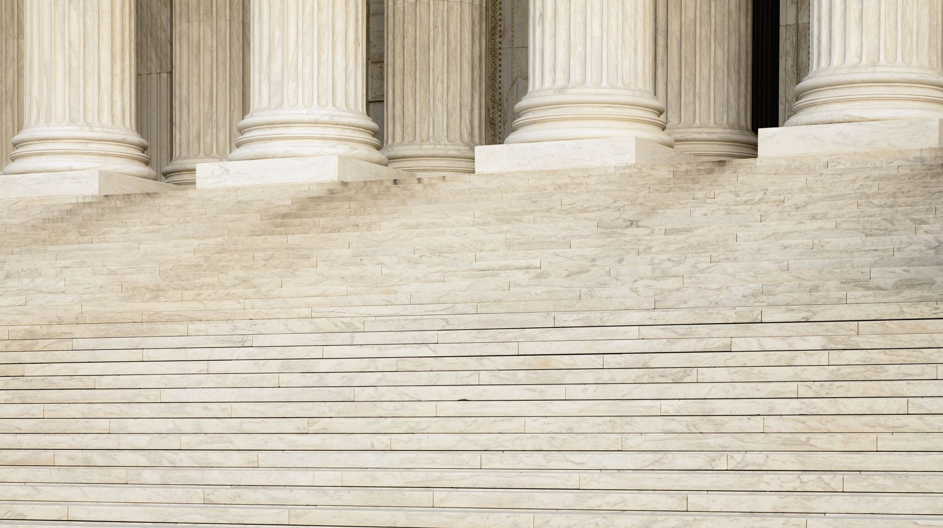
WRIT OF AMPARO
a remedy for when the right to life, liberty, and security of an individual is endangered, violated or threatened with violation by an unlawful act or omission of a public official or employee, or of a private individual entity.
Covers extralegal killings and enforced disappearances or threats
Interim Reliefs:
Temporary protection of order
Inspection Order
Production Order
Witness protection order

Slide 18

WRIT OF HABEAS DATA
ACCESS TO INFORMATION
Notes:
STOCK PHOTO FROM POWERPOINT

Slide 19
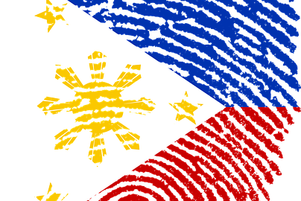
WRIT OF HABEAS DATA
available as remedy to any person whose right to privacy in life, liberty or security is violated or threatened by an unlawful act or omission of a public official or employee, or of a private individual or entity engaged in the gathering, collecting or storing of data or information regarding the person, family, home and correspondence of the aggrieved party
Requirements of verified petition for a writ of habeas data:
Personal circumstances of petitioner and respondent
How the right to privacy is violated or threatened and how it affects the right to life, liberty, or security of the aggrieved party
Actions and recourses taken by the petitioner to secure data
If it is known, location of the files, registers or databases, the government office, and the person in charge, in possession, or in control of the data or information
Reliefs prayed for, could include updating, rectification, suppression, or destruction of information or files kept by the respondent
If allegations in the petition are found to be substantial, the court shall order the deletion, destruction or rectification of the erroneous data or information.
This Photo by Unknown Author is licensed under CC BY-SA

Slide 20

Data Privacy Act of 2012
Right to ensure that information of private sectors and government are secured and protected.
National Privacy Commission
an independent body, created under Republic Act No. 10173 or the Data Privacy Act of 2012
administers and implements RA 10173
ensures that the country complies with the international standards for data protection
In section 8, Commission must ensure the Confidentiality of any personal information in its knowledge or possession. There must be a disclosure of information to the public before information can be shared.
In section 20, those in control of information should ensure that it has been protected against any accidental or unlawful destruction, altercation and disclosure and unlawful processing.
This Photo by Unknown Author is licensed under CC BY-SA-NC
Notes:
STOCK PHOTO FROM POWERPOINT

Slide 21
Data Privacy Act of 2012
Penalties: Unauthorized processing of Personal information shall be penalized by imprisonment ranging from (1) year to three (3) years with a fine of not less than five hundred thousand Pesos(php500, 000.00) but not more that two million pesos(Php2,000, 000) shall be imposed on the persons who process personal information without consent of the data subject.
Data sharing can be allowed under the following circumstances:
if authorized by law, provided there are adequate safeguards for data privacy and security.
if data subject consents to data sharing in private sectors.
if collected from parties for the purpose of research
If it is between government agencies for the purpose of a public function or provision
This Photo by Unknown Author is licensed under CC BY-SA-NC
Notes:
STOCK PHOTO FROM POWERPOINT

Slide 22
Data Privacy Act of 2012
Under this act as well, the National Privacy Commission will check whether companies are compliant based on 5 elements:
1) Appointing a Data Protection Officer
2) Conducting a privacy impact assessment
3) Creating a privacy knowledge management program
4) Implementing a privacy and data protection policy
5) Exercising a breach reporting procedure
This Photo by Unknown Author is licensed under CC BY-SA-NC
Notes:
STOCK PHOTO FROM POWERPOINT

Slide 23
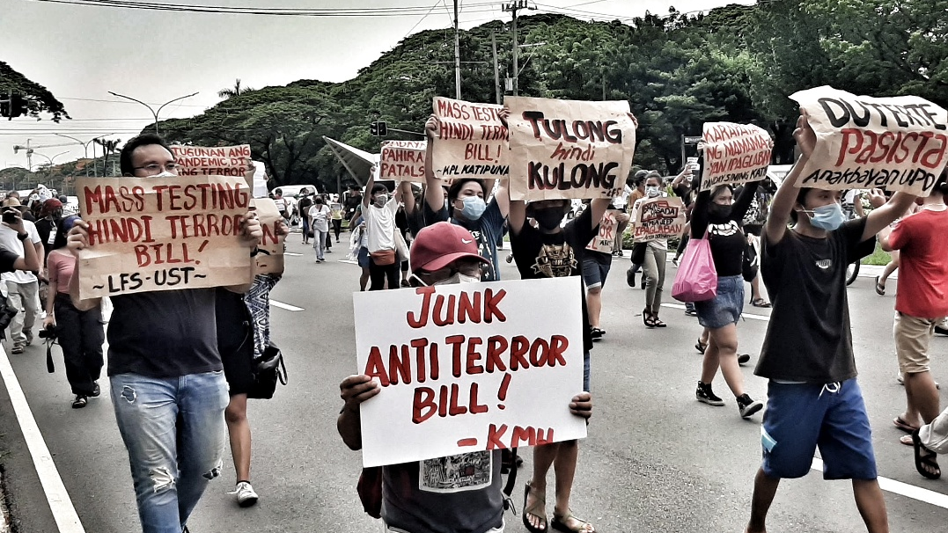
ANTI-TERROR LAW
2020
This Photo by Unknown Author is licensed under CC BY-SA
Notes:
STOCK PHOTO FROM POWERPOINT

Slide 24
ANTI-TERROR LAW
This law amends the 2007 Human Security Act and imposes as rougher response to terrorism in the Philippines.
Creates a council, who are appointed by the president, that can designate individuals and groups as terrorists and detain them without charge or warrant for up to 24 days.
Allows surveillance and wiretaps, and punishments that include life imprisonment without parole.
Terrorist acts
individual or groups’ intent to cause death and damage property.
Subject of heavy criticism
“No law shall be passed infringing on the freedom of speech and expression, the freedom of assembly, and the right to petition the government for a redress of grievances. “ - 1987 Constitution
#JunkTerrorLaw

Slide 25
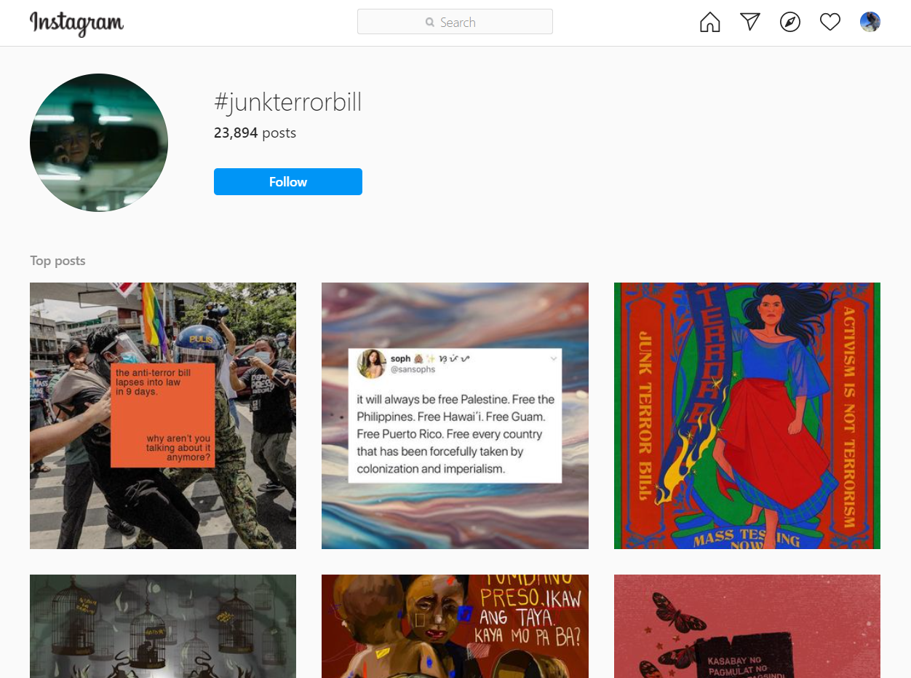

Slide 26
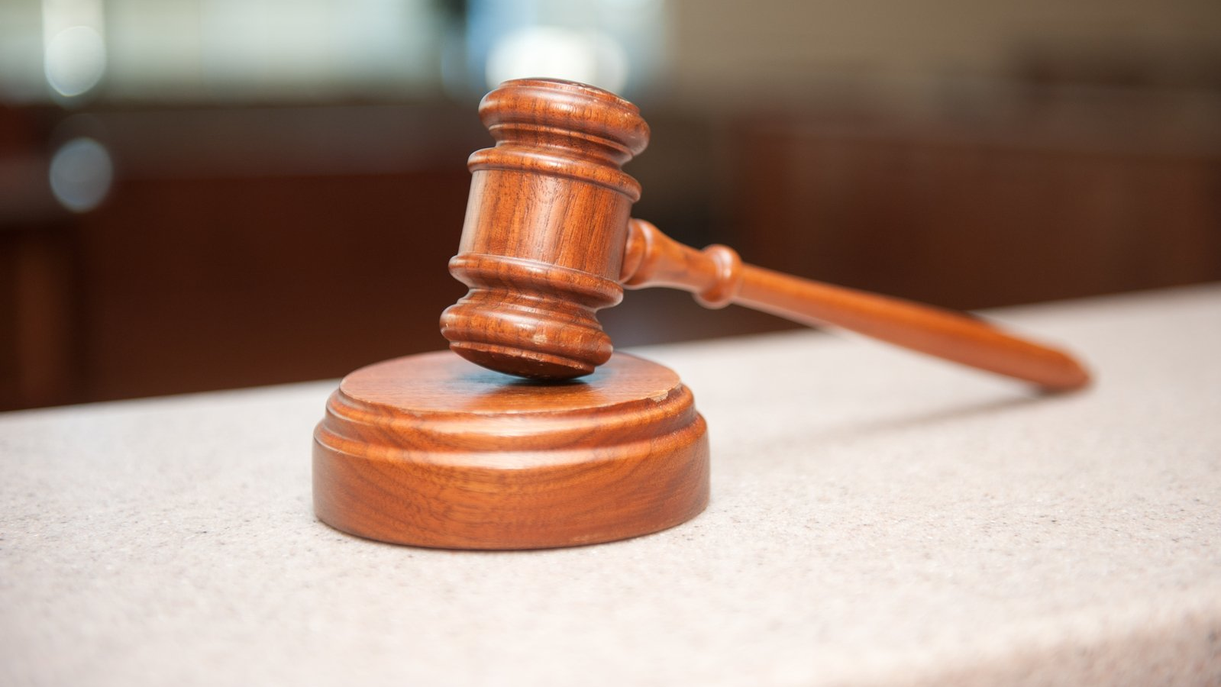
CASES
Notes:
Photo from https://www.freeimages.com/photo/gavel-2-1236453

Slide 27
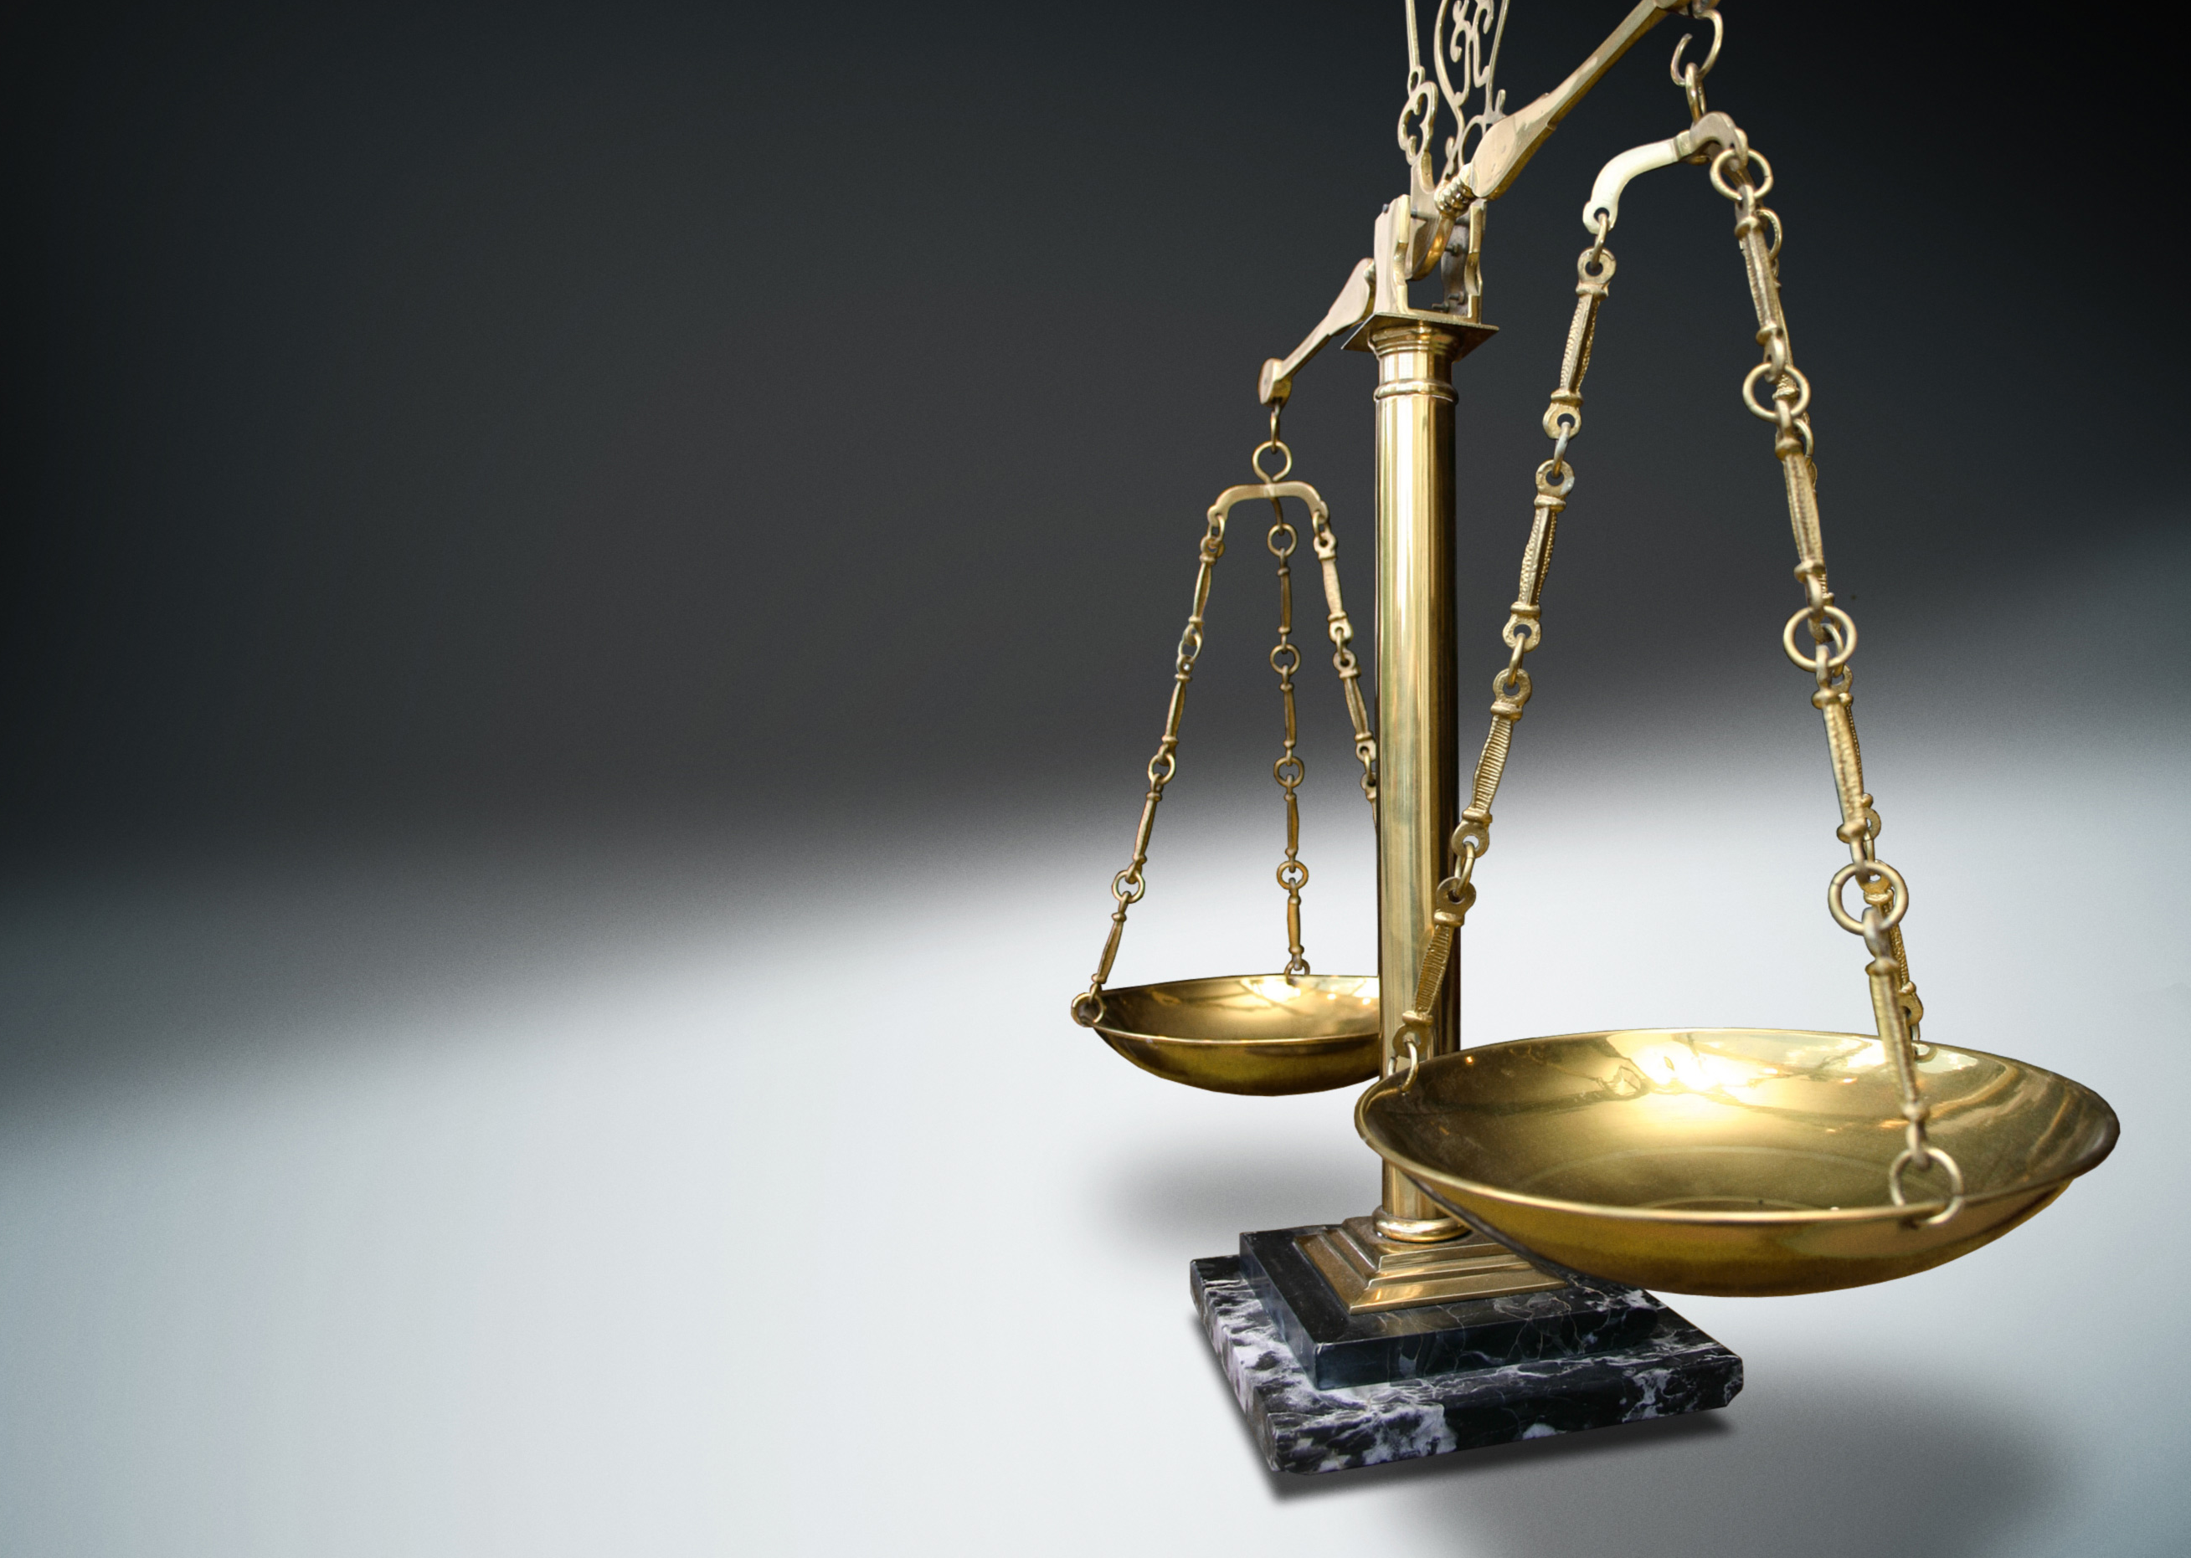
THE SECRETARY OF NATIONAL DEFENSE, THE CHIEF OF STAFF, ARMED FORCES OF THE PHILIPPINES, petitioners, vs. RAYMOND MANALO and REYNALDO MANALO, respondents.
February 14, 2006 two brothers Raymond and Reynaldo Manalo were abducted by members of the armed forces because they were suspected to be members and/or supporters of the New Peoples’ Army.
They were detained and tortured for 18 months before managing to escape.
The Manalo brothers filed for a petition of Prohibition, Injunction and a Temporary Restraining Order in attempt to put an end to the military depriving them of their basic rights.
Motion filed to treat the existing petition as the new Writ of Amparo
Writ of Amparo was granted in the Manalo brothers favor, despite petitioners efforts to reverse the decision of granting the Writ.
This Photo by Unknown Author is licensed under CC BY-SA-NC

Slide 28
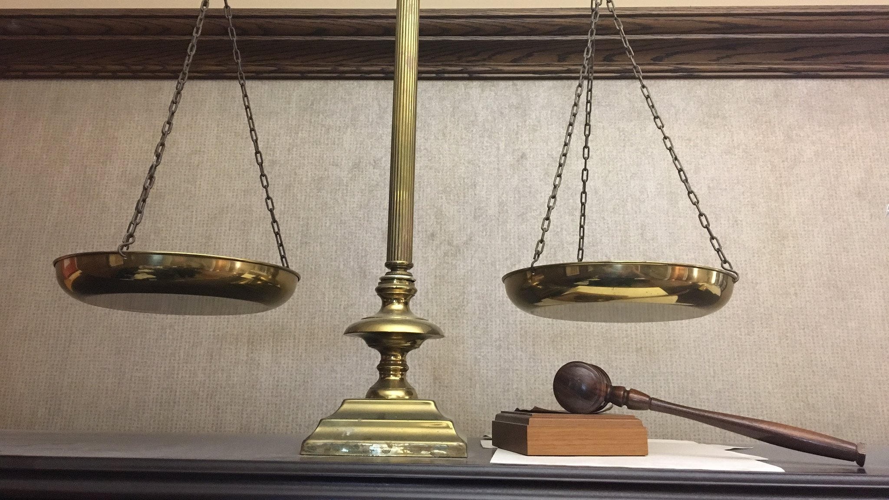
Rodriguez Vs. Macapagal-Arroyo
Noriel Rodriguez is a member of a peasant organization, under a counterinsurgency campaign at the time any members of these organizations were flagged as enemies of the state.
On September 6 2009, Noriel was abducted and tortured in an attempt to get him to admit his involvement with the organization. Rodriguez was taken to a military camp and was continuously tortured until his family and members of the Commission on Human Rights(CHR) went to see him and brought him home.
Upon arriving home, two military members along with a member of the Commission of Human Rights entered his home and took photos for 30 minutes.
Weeks later Rodriguez and his girlfriend noticed men following them around on the streets and public transit.
On December 7th Rodriguez filed a petition for a Writ of Amparo, Writ of Habeas Data with Prayers for Protection Orders, Inspection of Place and Production of Documents and Personal Properties. These petitions were filed against President Arroyo, military personnel and the Commission of Human Rights representative. The Supreme Court approved the writs and ruled in favor of Rodriguez.
Ultimately the case was dismissed in favor of the respondents because the court concluded that Rodriguez failed to prove his case through substantial evidence.
This Photo by Unknown Author is licensed under CC BY-SA

Slide 29

NATIONAL UNION OF PEOPLE’S LAWYERS (NUPL), PETITIONERS VS. PRESIDENT RODRIGO DUTERTE, RESPONDENT
NUPL is a nationwide voluntary association of human rights lawyers, law students and legal workers in the Philippines.
They claim to have been threatened for being members of the NUPL and for handling and representing the cases of political prisoners, peace consultants arrested by state agents, and for pursuing issues regarding extra-judicial killings, among others.
The Supreme Court, en banc, issued a writ of amparo and habeas data in favor of the National Union of People’s Lawyers (NUPL).

Slide 30
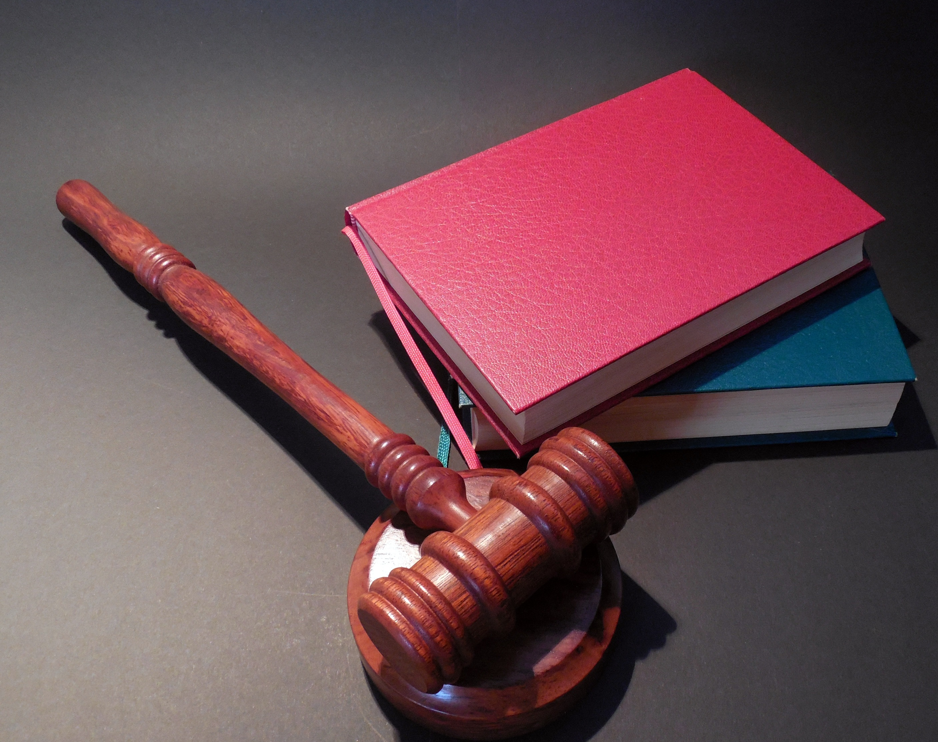
SENATOR LEILA DE LIMA VS. PRESIDENT RODRIGO DUTERTE, RESPONDENT
Senator De Lima files a petition for writ of habeas data against the respondent.
She requests for the Court to compel the respondent to remove the damaging information about the petitioner as it violates her rights to privacy.
This was after the respondent, President Duterte, made several speeches that accuses the senator of having links to drugs. He also called De Lima an “immoral, dirty woman” referencing an alleged affair De Lima has with Ronnie Dayan, a former bodyguard of De Lima.
The court unanimously denied the petition as in this case, the President is immune from criminal, civil, and administrative suit.

Slide 31
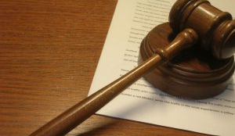
Secretary Leila De Lima, Director Nonnatus Rojas and Deputy Director Reynaldo Esmeralda, petitioners Vs. Magtanggol Gatdula, respondent
February 27, 2012 Gatdula filed a petition for the issuance of a Writ of Amparo directed against petitioners Justice De Lima, Director Rojas and Deputy Esmerala
Gatdula wanted De Lima to cease and desist because Gatdula said he was being framed for false charges of Frustrated Murder against him
The Writ of Amparo was not issued but a summons and order on De Lima was to file an answer
The Regional Trial Court granted temporary protection, production and inspection orders.
It was unclear from the records how the pieces of evidence would be related to the alleged threat to life, liberty or security of Gatdula.
This Photo by Unknown Author is licensed under CC BY-SA-NC

Slide 32
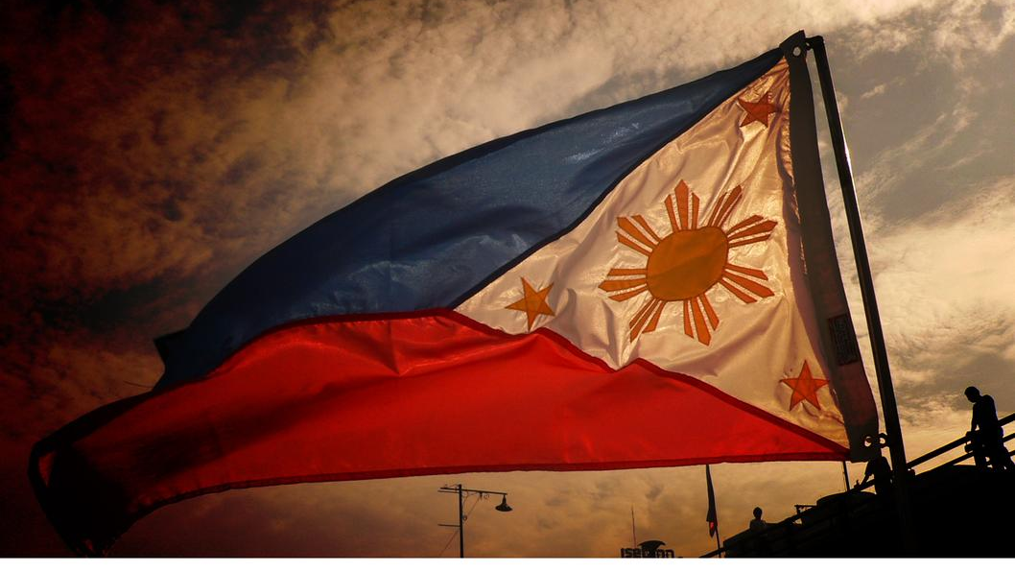
CONCLUSION
This Photo by Unknown Author is licensed under CC BY-NC-ND

Slide 33
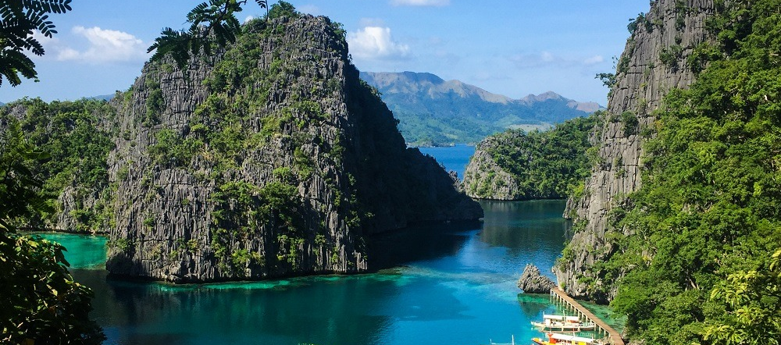
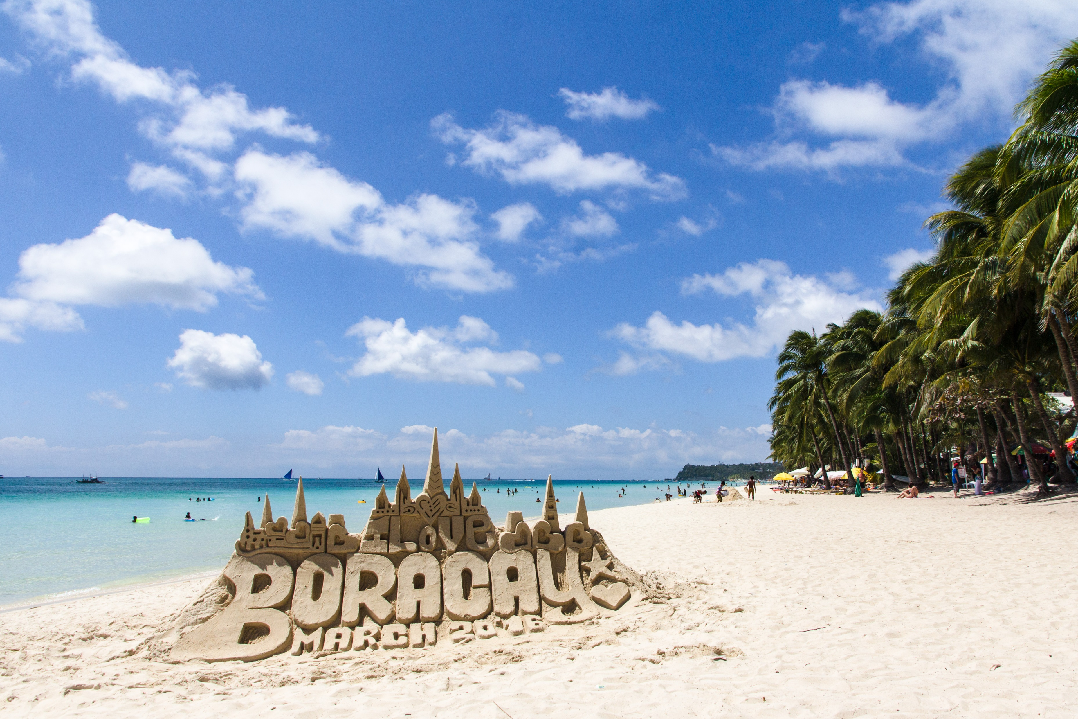

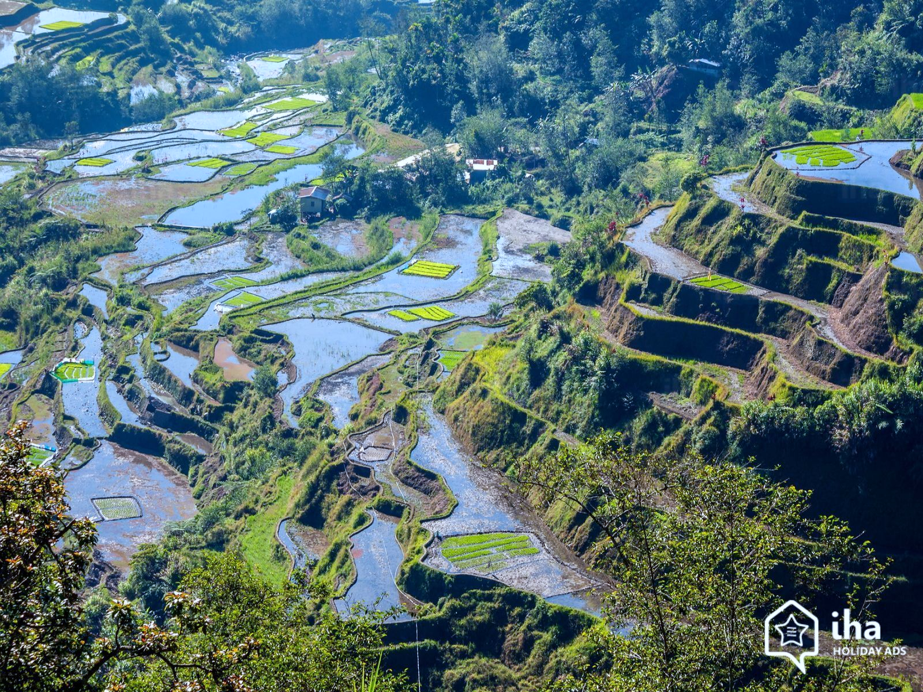
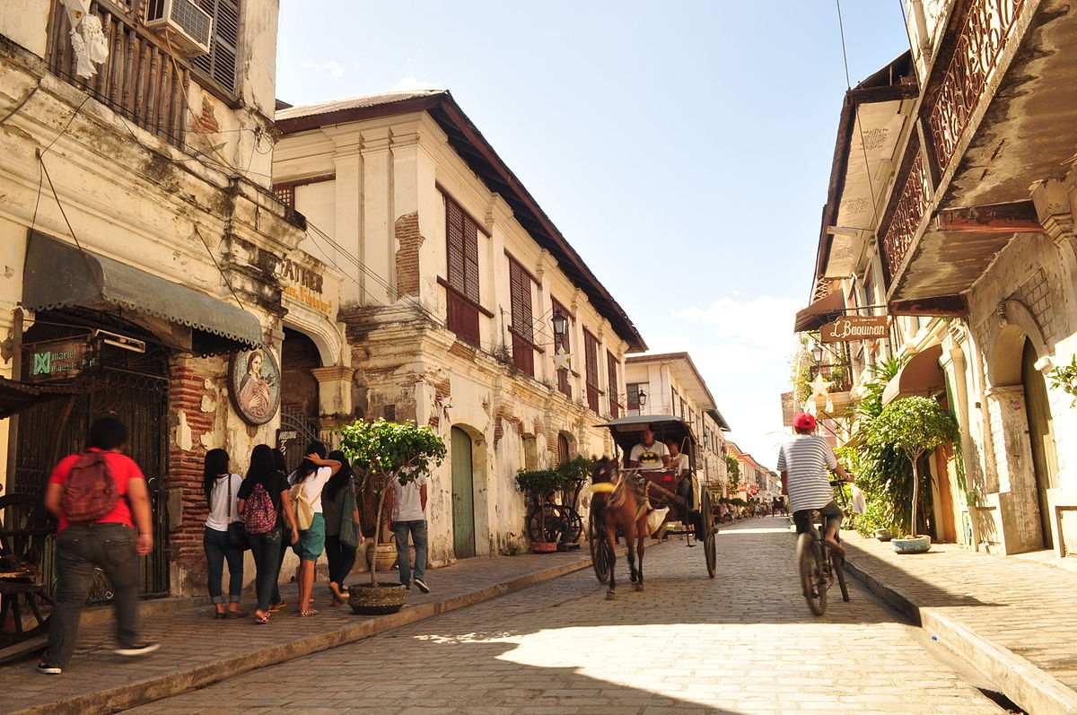

This Photo by Unknown Author is licensed under CC BY-NC-ND
This Photo by Unknown Author is licensed under CC BY-SA
This Photo by Unknown Author is licensed under CC BY-SA-NC
This Photo by Unknown Author is licensed under CC BY-SA-NC
This Photo by Unknown Author is licensed under CC BY-NC-ND
This Photo by Unknown Author is licensed under CC BY-SA

Slide 34
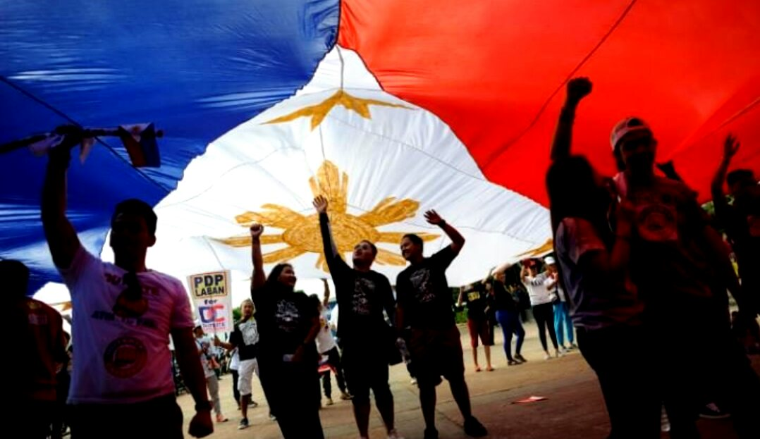
THANK YOU.
ISEC3050 ETHICS & LAW IN DATA ANALYTICS(COUNTRY CASE) BY:
BROWNE, CHERISH
LU, JAMIE
ODEBUNMI, ISLAMIYAT
SMITH, LEEANN
DECEMBER 2020
This Photo by Unknown Author is licensed under CC BY-SA

Slide 35
Questions?

